Slide 2
Your Reliable and Efficient Design Tool

Slide 3
Seamless Compatibility

Slide 4
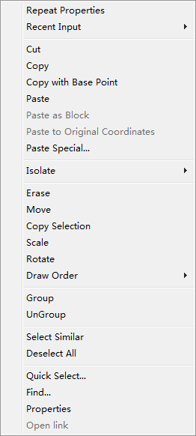
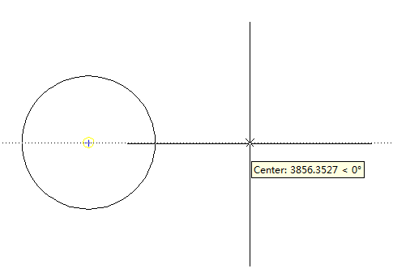
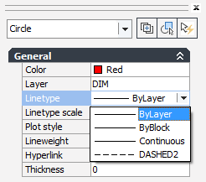
Zero Relearning Cost
Command
Menu list
Shortcut keys
Operations

Slide 5
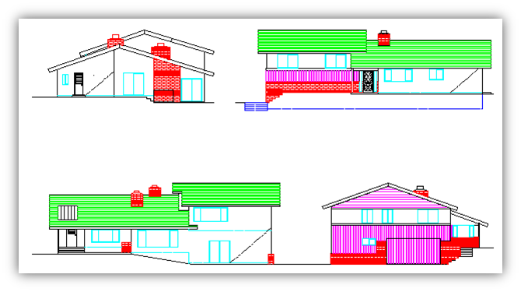
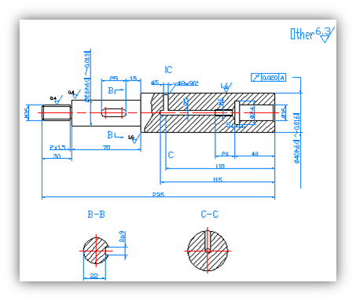
Efficient Design- Drafting

Slide 6
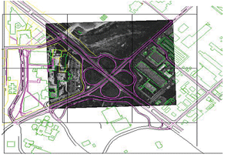
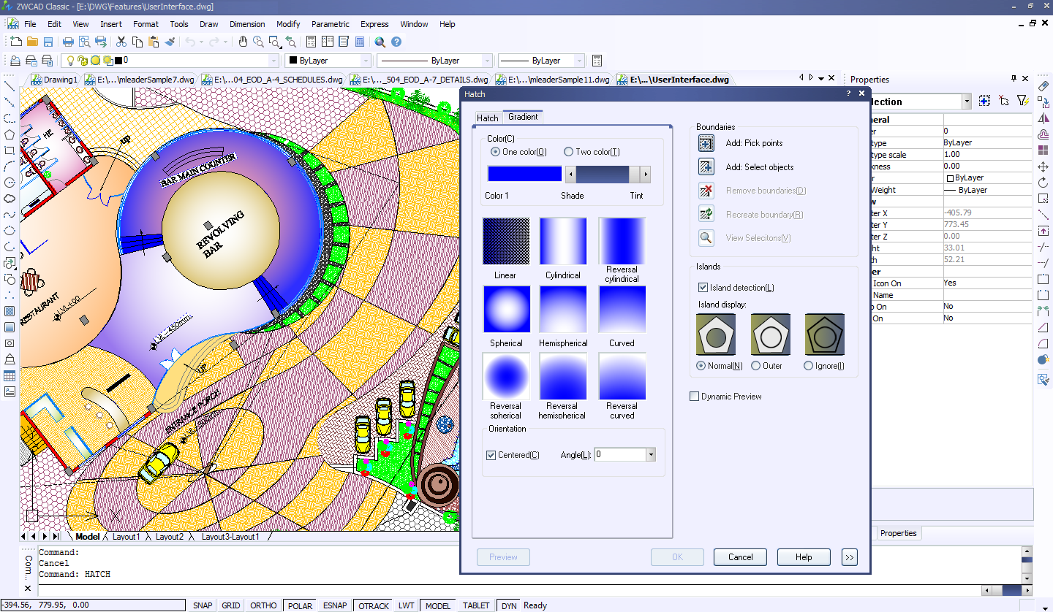
Efficient Design- Drafting
Image
Hatch
An important reference for designers
ZWCAD Classic supports numerous image formats, including BMP, TIF, GIF, JPG, PNG, PCX, TGA and ECW.
Hatch makes the drawing vivid during a presentation.
ZWCAD Classic supports .pat files from other mainstream CAD software.

Slide 7
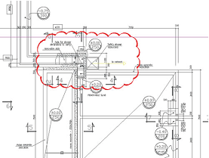
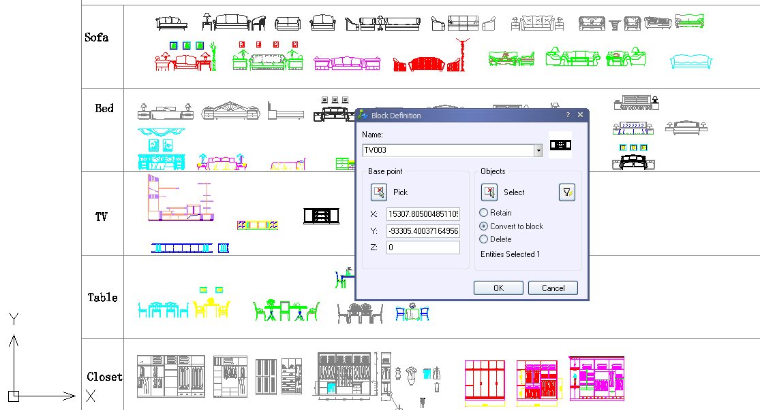
Efficient Design- Drafting
Block
Revision Cloud
Standardize drawing components and reuse
Attribute blocks can embed any kind of textual information such as inventory numbers, prices, and multi-line detailed descriptions.
Call attention to areas that contain revisions
You can select revision cloud style, normal, calligraphy, or converted from objects

Slide 8
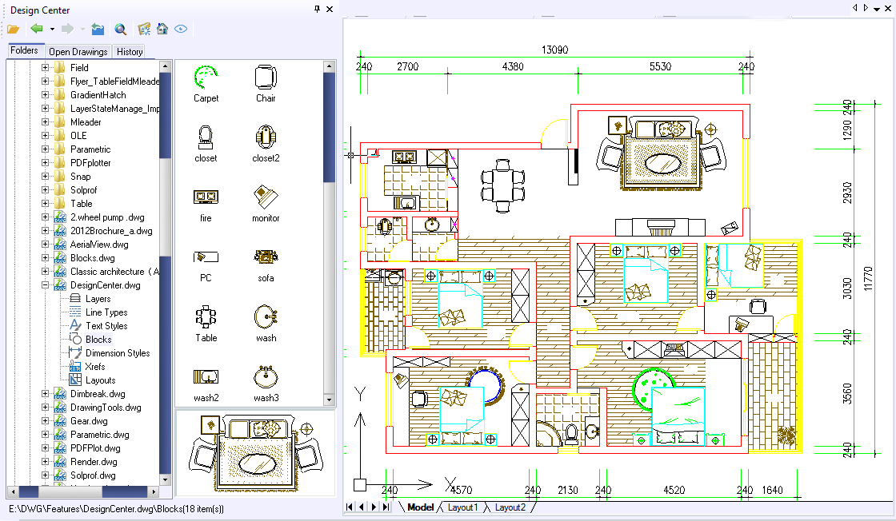
Efficient Design- Management
Design Center
Allows you to search and access any CAD resource stored locally or on the local network.
Reuse the content from other drawings, such as dimension styles, blocks, text styles, line types, and even layers

Slide 9
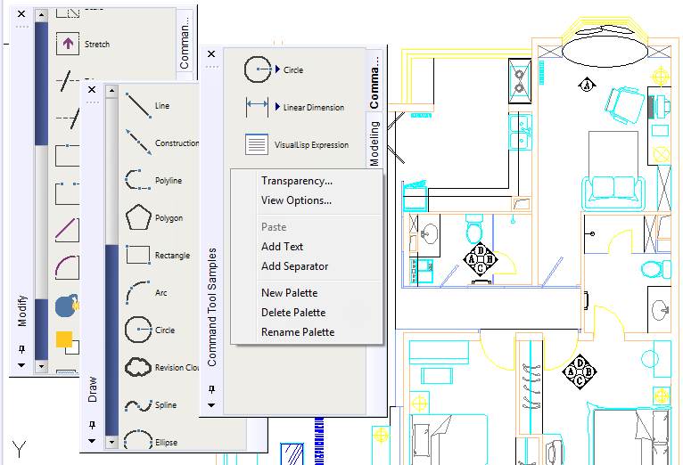
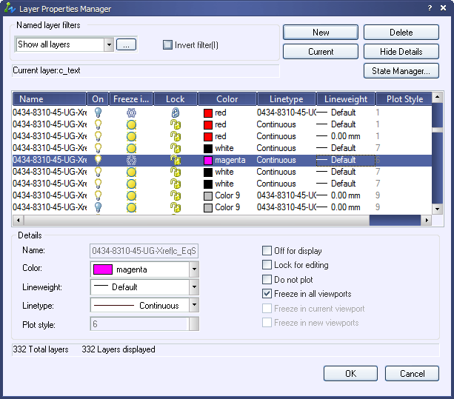
Efficient Design- Management
Tool Palettes
Layer Properties Manager
Provides an efficient way to organize, share, and store "tools", such as blocks, hatch patterns, entities, and even content from third-party developers
Lists all the layers and their properties for batch processing.
Edit the properties and applying changes in the manager

Slide 10
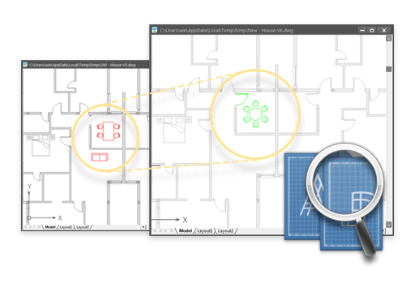
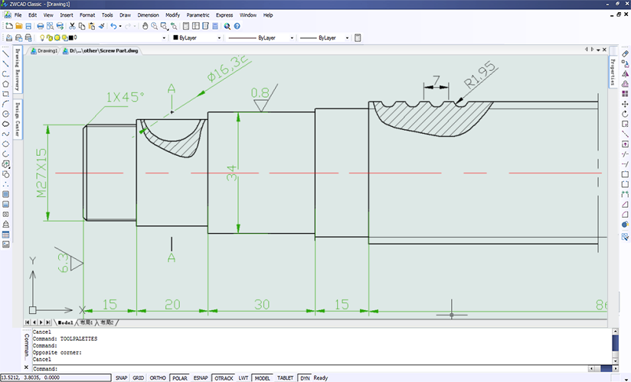
Efficient Design- Time Saving
File Compare
Breaking Dimension Line
Spots the differences between similar drawings and highlights them in different colors and tells you what changed, which can be very helpful in teamwork
Breaks dimension lines where they cross other lines -- without splitting the lines
The broken dimension lines are still easy to adjust.

Slide 11
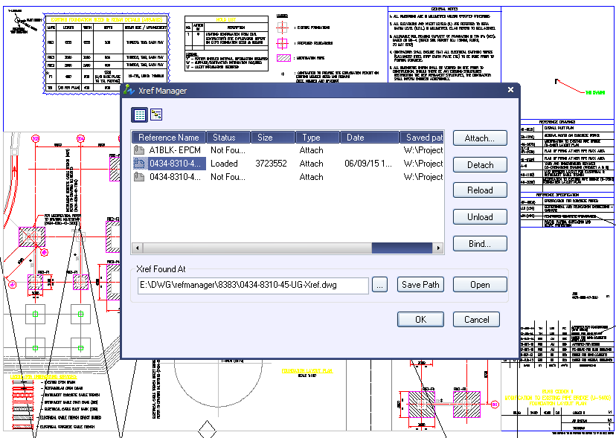
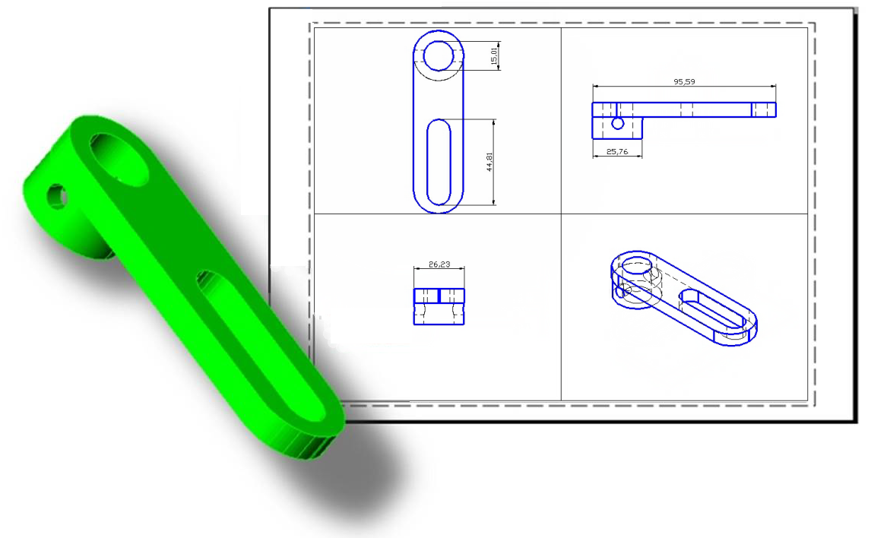
Efficient Design- Time Saving
External Reference
Solid Profile
Insert entire DWG files as external references. This lets everyone on your team collaborate together on big designs, yet won't increase the drawing file size by much
Creates profiles of 3D solids with ease.
You can specify 2D and 3D profiles. Hidden and visible lines are placed onto different layers automatically.

Slide 12
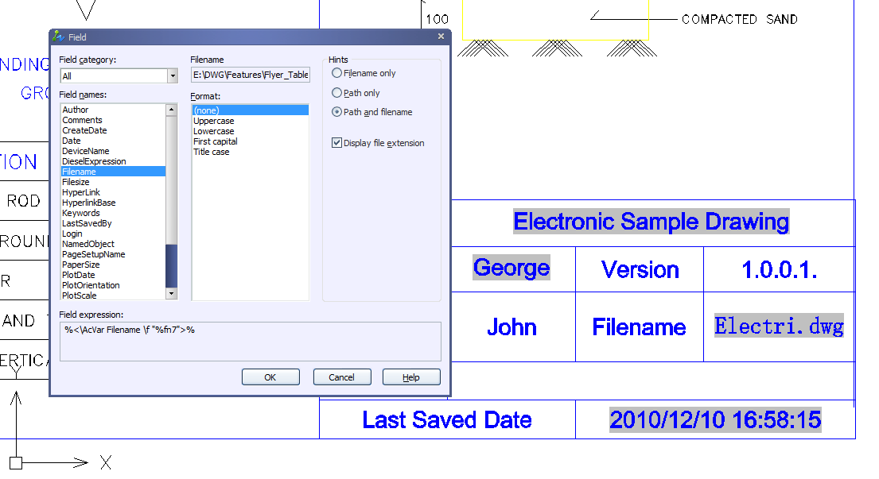
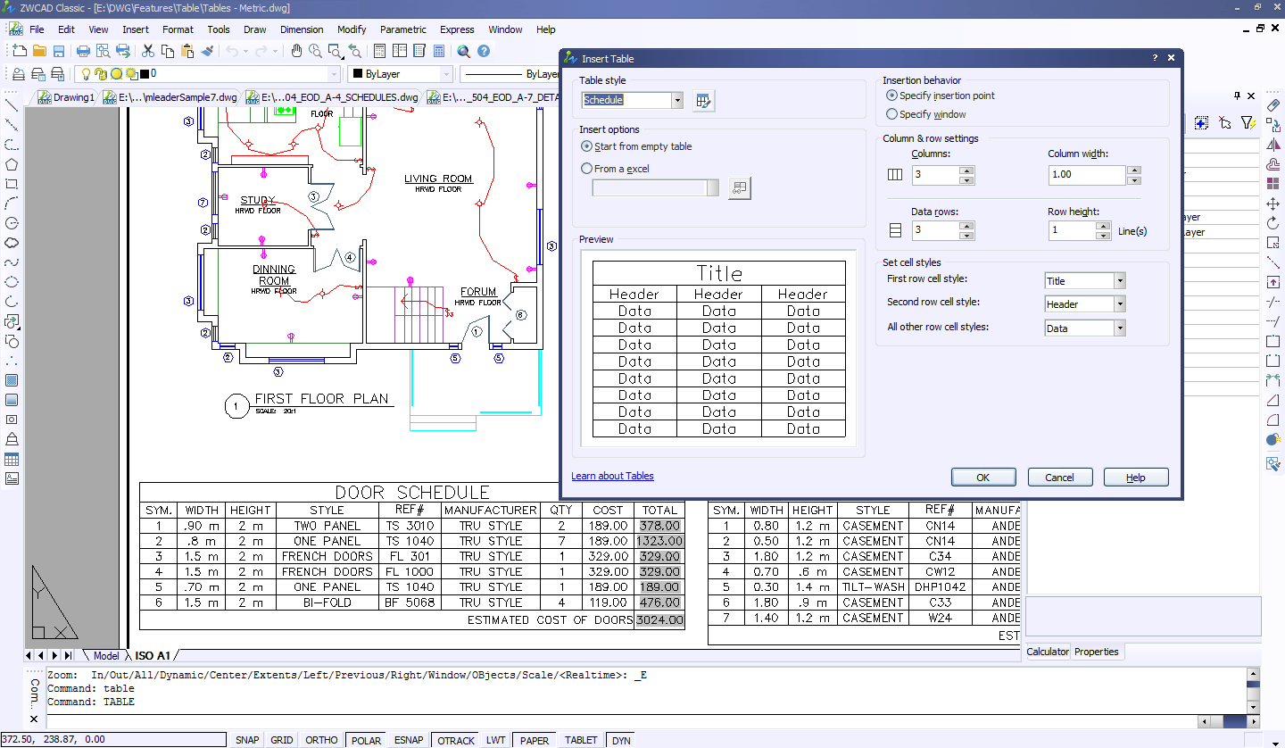
Efficient Design- Time Saving
Field
Table
Sometimes you need to update textual information in drawings. This painstaking task is solved with the field function. It updates information for you automatically
Create neat tables just in a single step.
In-place editing allows you to edit the contents of table cells
tables can export and import data files to and from Excel spreadsheets

Slide 13
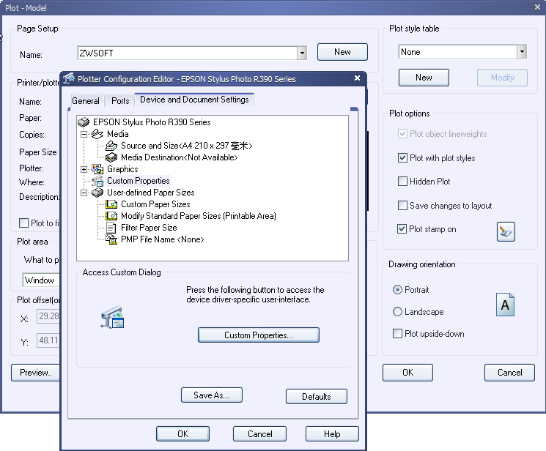
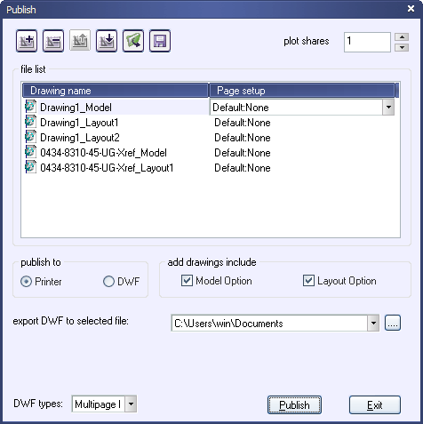
Efficient Design- Output
Plot
Publish
You can plot drawings to both files and paper
Multiple options can help you to fine-tune the results, including specifying the paper size, setting the plot scale, selecting a plot style, and adding a plot
With Publish, models and layouts can be published to a single or multi-page DWF file or plotter. This allows you to share drawings with coworkers or clients safely and quickly

Slide 14
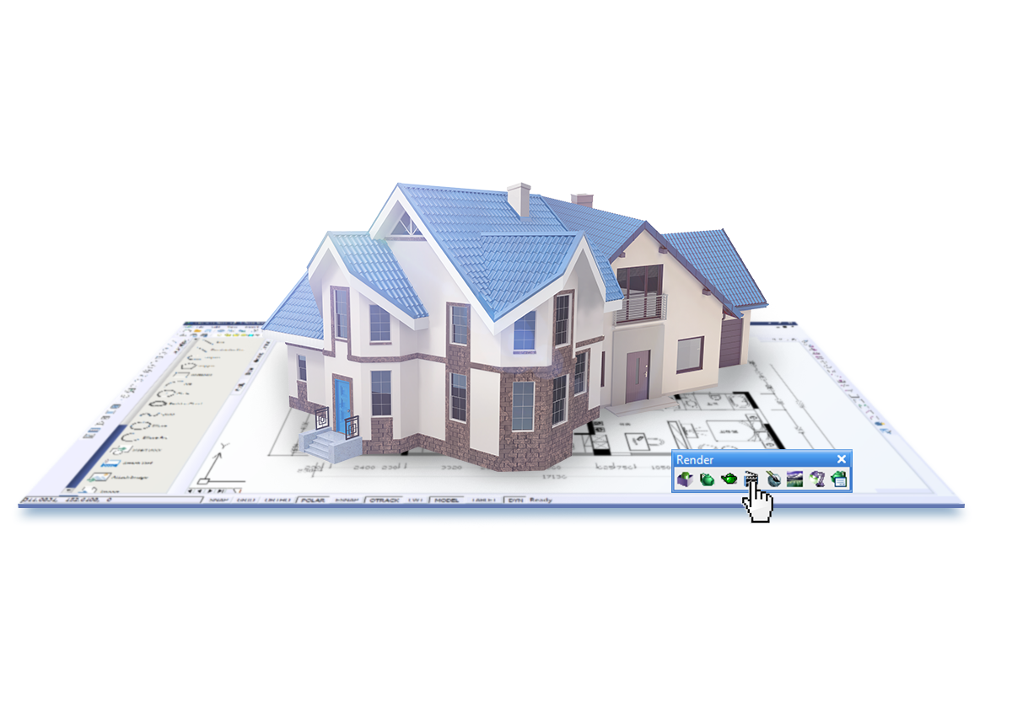
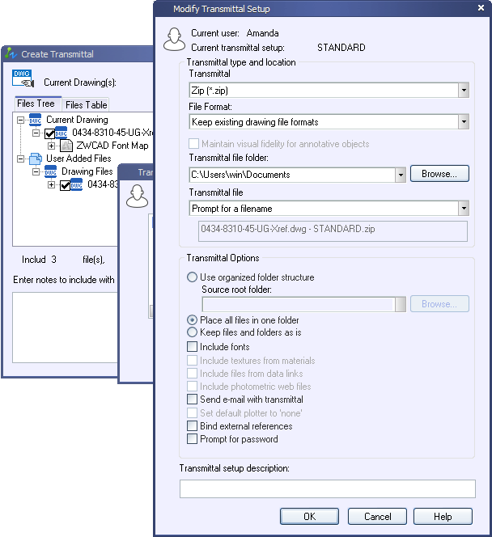
Efficient Design- Output
eTransmit
Render
Collects all of the related drawings and support files and puts them into one package
The package includes the drawings, images, external references, fonts and other files you might want to attach
Provides a rich variety of materials, multiple light types, and environmental settings to generate renderings. It is a good way to show off your design vision, and to verify it with others.

Slide 15
Good Service
Local onside support in 80 countries
FAQ solution library
24/7 online forum support

